Slide 1

Backup and storage

Slide 2
What will this presentation contain
What is a backup and why is it done
Types of backup
Storage methods
Common issues with backups

Slide 3
Backup process
In information technology, a backup, or data backup, or the process of backing up, refers to the copying into an archive file of computer data so it may be used to restore the original after a data loss event.
The client that sends the backup data is called SOURCE and the recipient is called DATA STORAGE

Slide 4
Backup storage
Backup storage refers to a storage device, medium or facility that is used for storing copies and instances of backup data. Backup storage enables the maintenance, management, retrieval and restoration of backup data for any individual, application, computer, server or any computing device.

Slide 5
Backup storage
Backup storage is primarily an additional storage device used for keeping backup data.
Typically, it is external to the system, server or device for which the backup data is created, such as a local/remote storage server.
The backup storage itself can be a hard disk drive, tape drive, compact disk drive or any mass storage medium installed within a computer or storage server. In enterprise IT environments, the backup storage medium/technology used can be RAID, a storage area network or a network-attached storage system.
Backup software or a backup manager is used to create, store, manage and retrieve backup data to and from the backed up application/device and the backup storage location.

Slide 6
Types of backup
Four most common types of backup
Full backup
Incremental backup
Differential backup
Mirror backup

Slide 7
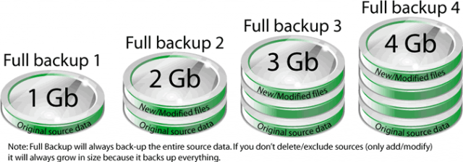
Full backup
Every single file and folder in the system is backed up
Takes longer
Restoration process is easier and faster
Is used for the other methods of backup

Slide 8
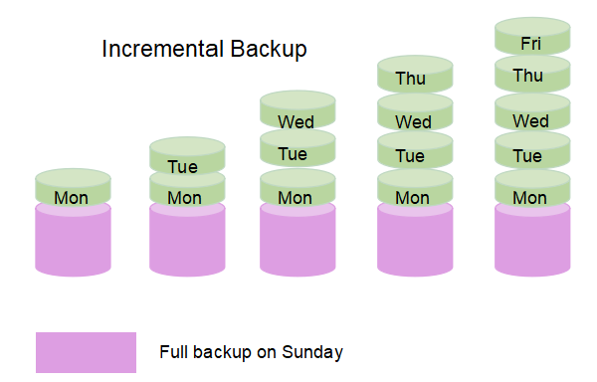
Incremental backup
Only the initial backup is full
Subsiquent backups only store changes that were made since the last backup
The process restoring data is longer
Backup process is much faster

Slide 9
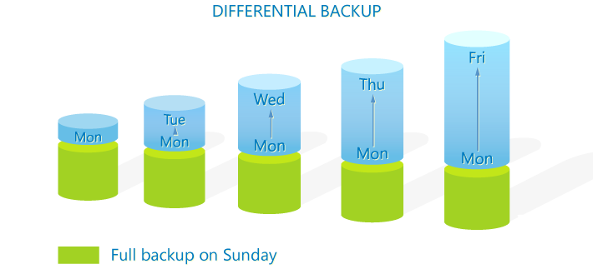
Differential backup
Only the initial backup is full
Subsequent backups only store changes that were made since the last backup
The difference is that while an incremental backup only includes the data that has changed since the previous backup, a differential backup contains all of the data that has changed since the last full backup.

Slide 10
Mirror backup
Only the initial backup is full
Mirror backups are as the name suggests a mirror of the source being backed up.
With mirror backups, when a file in the source is deleted, that file is eventually also deleted in the mirror backup.
Because of this, mirror backups should be used with caution as a file that is deleted by accident, sabotage or through a virus may also cause that same file in mirror to be deleted as well. Some do not consider a mirror to be a backup

Slide 11
Back up storage
Magnetic type
Hard disk
Optical storage
SSD
Remote backup services

Slide 12
Magnetic tape
This is a storage device that contains one or more tape drives, a number of slots to hold tape cartridges, a barcode reader to identify tape cartridges and an automated method for loading tapes (a robot). Additionally, the area where tapes that are NOT currently in a silo are stored is also called a tape library. Some tape libraries contain literally millions of tapes.

Slide 13
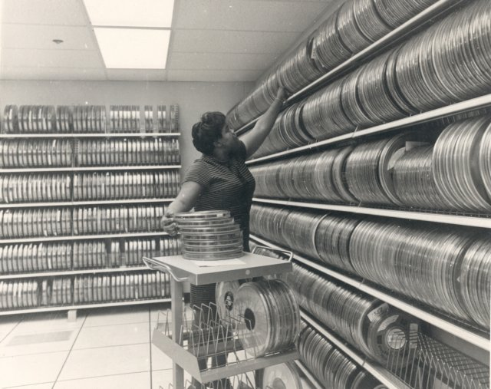
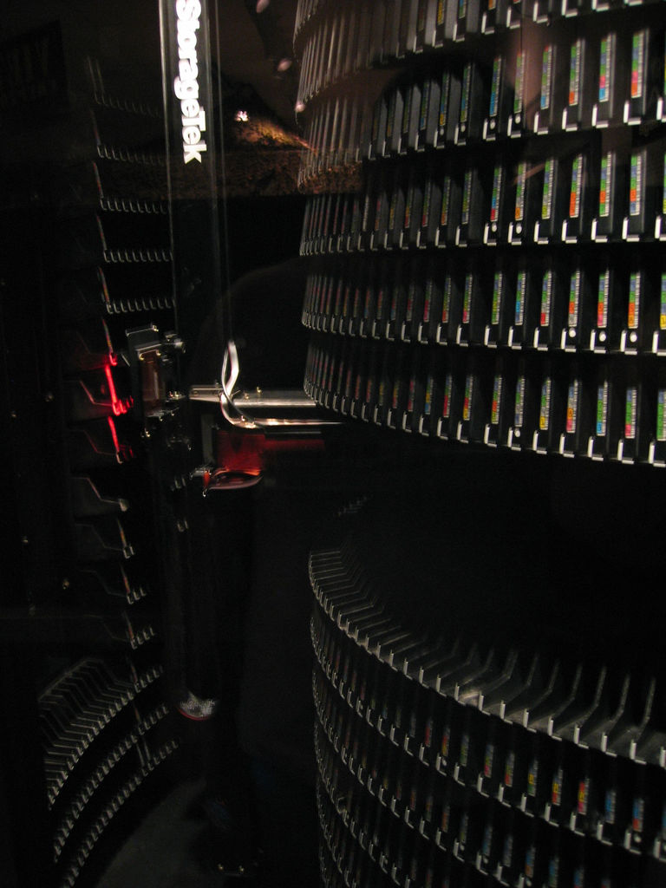
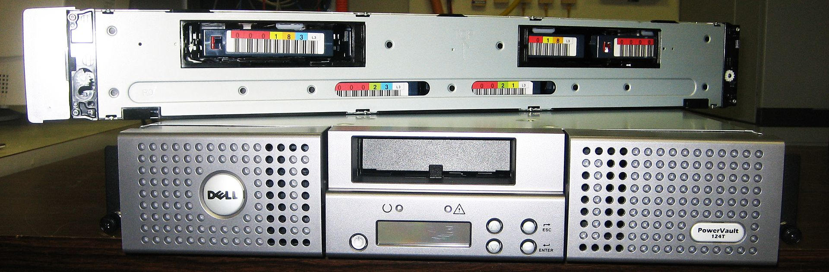
Magnetic tape

Slide 14
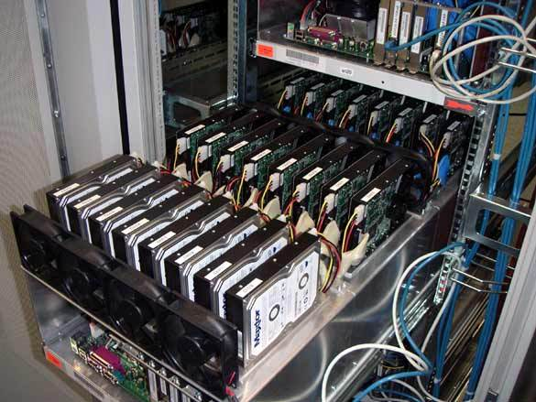
Hard disks
The capacity-to-price ratio of hard disks has been improving for many years, making them more competitive with magnetic tape as a bulk storage medium.
The main advantages of hard disk storage are low access times, availability, capacity and ease of use.
External disks can be connected via local interfaces like SCSI, USB, FireWire, or eSATA, or via longer distance technologies like Ethernet, iSCSI, or Fibre Channel.
Some disk-based backup systems, via Virtual Tape Libraries or otherwise, support data deduplication, which can dramatically reduce the amount of disk storage capacity consumed by daily and weekly backup data

Slide 15
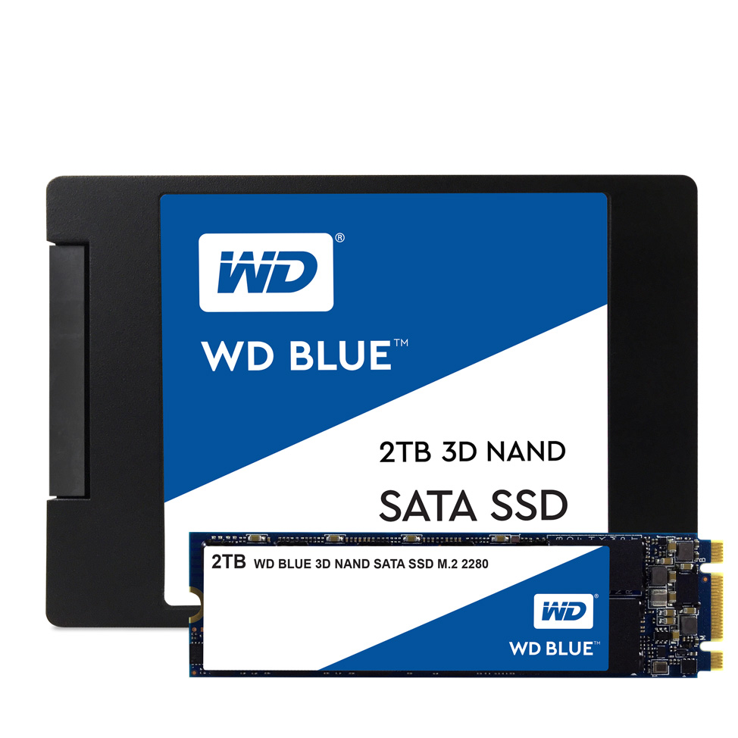
Solid state drives
Also known as flash memory, thumb drives, USB flash drives, CompactFlash, SmartMedia, Memory Stick, Secure Digital cards, etc.
Relatively expensive for their low capacity in comparison to hard disk drives, but are very convenient for backing up relatively low data volumes.
A solid-state drive does not contain any movable parts unlike its magnetic drive counterpart, making it less susceptible to physical damage, and can have huge throughput in the order of 500Mbit/s to 6Gbit/s. The capacity offered from SSDs continues to grow and prices are gradually decreasing as they become more common.
Over a period of years the stability of flash memory backups is shorter than that of hard disk backups.
Notes:
flash memory devices tends to have a shorter retention period and may be more prone to degradation over time compared to data stored on hard disk drives, making HDDs a preferred choice for long-term backups.

Slide 16
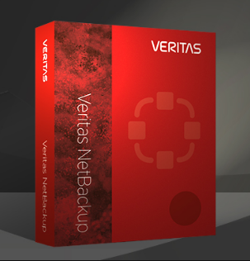
Remote backup services
Backing up via the Internet to a remote location can protect against events such as fires, floods, or earthquakes which could destroy locally-stored
Support is responsibility of a third party company
Requires high speed internet connection, especially the upload link

Slide 17

Data backup failure
Media failure
Human error
Software failure
Hardware failure
Network failure

Slide 18
Media failure
Media failure ranks at the top of nearly every list of reasons backups and restores fail.
What to do?
Taking care of the equipment according to manufacturer’s schedules and instructions
Redundant power supplies
Hot spare parts

Slide 19

Human error
Improper maintenance
Lack of training
Too much human interaction in the backup operations
What to do?
Trainings and rules

Slide 20
Software failure
Updates go wrong or include new settings which prevent the backup operations to happen (turning on firewall automatically)
Misconfigurations – backup softwares have plenty of options and settings. If not set up correctly, this could result in incomplete backups or total failures
What to do?
Handle with care and attention to detail

Slide 21
Hardware failure
Hardware that is taking part in backing up and storage gets old or suffers from defects. This could mess up the entire process.
What to do?
Use only quality and up to date equipment and hardware.
Perform checks
Change equipment according to a schedule

Slide 22
Network failure
Backing up via network increases up efficiency by reducing number of local devices
Misconfigurations is the main reason for network failures
What to do?
Networks are not only used for backups so problems should be more obvious by performing network troubleshooting.

Slide 23
Prevention
Whatever the cause of failure, the best way to keep them from damaging your organization is to verify your backups by performing regular test restores
Testing your backups regularly won't prevent backup failures, but they can help in noticing the issue and this will allow you to fix the problem before you really need those backups and you get a nasty surprise.

Slide 24
The end

